Slide 1

TruText Ledger
User Manual
Leardo Taylor MCSD Programming 1 Formative 2

Slide 2
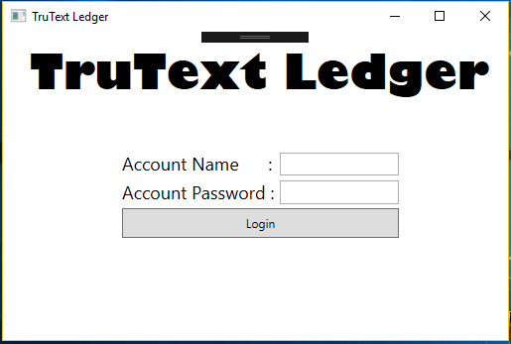
Login Page
Here you will log in by filling in your account details and pressing log in.

Slide 3
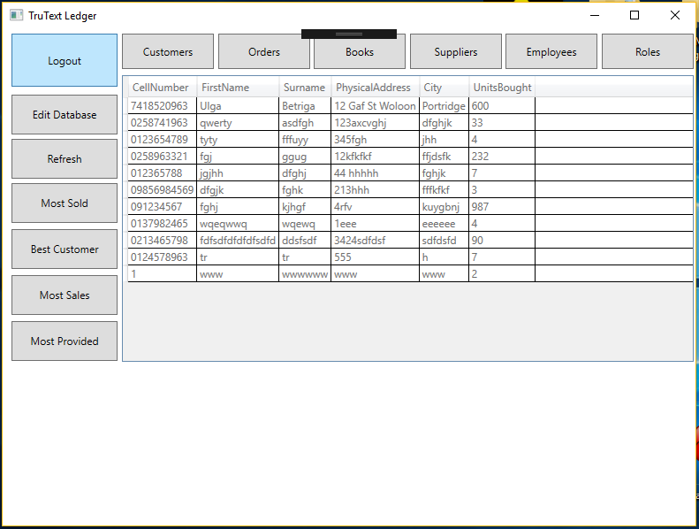
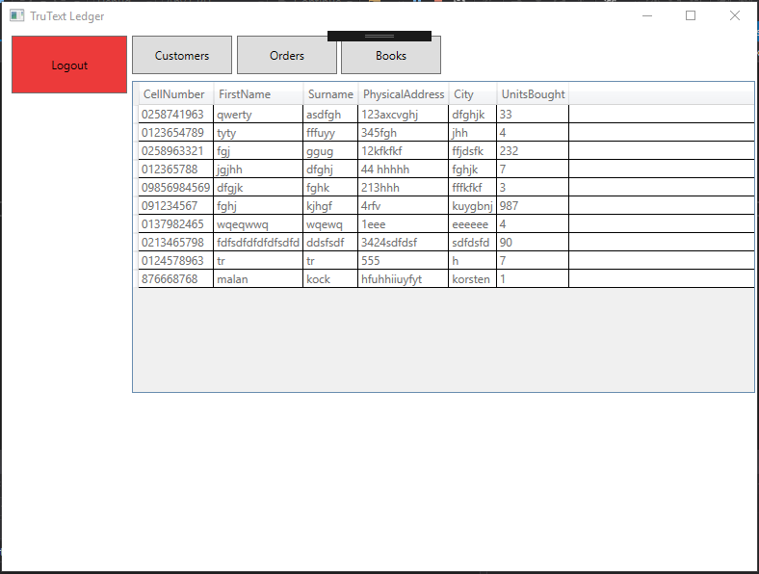
Viewer Page
Administrator User View
Logout Button: Lets you log out
Filter buttons: Let you filter what
Information is displayed or what
Talbe is chosen.
Table viewer: Allows you to view contents in database.
Refresh Button: Refreshes table viewer to show changes to the database.
Edit Button: allows you to manipulate data in the database.
Normal User View

Slide 4
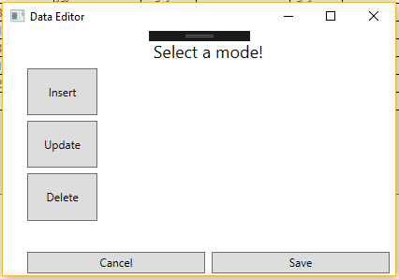
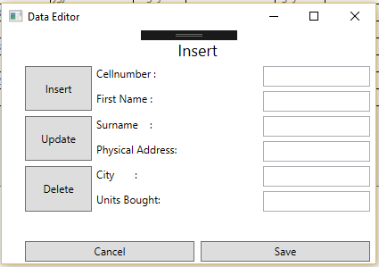
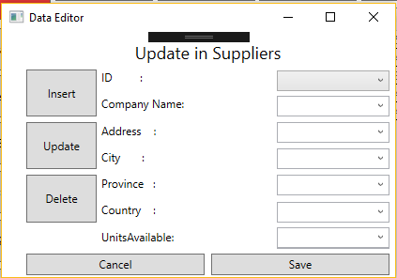
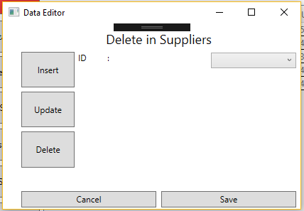
Editor Page
Default Layout
Insert View
This view opens up when edit button is pressed and does not allow input until a mode is selected.
This view allows the user to insert new data to the database. The top input is the primary key of all table.
Update View
Delete View
This is the update view which has a lot of combo boxes and only allows you to edit over existing data.
This is the delete view and allows you to delete items in the database accordingly to their Primary key.
The save button completes the selected mode and you must cancel after an operation is completed or if you don’t want to complete it.

